Slide 1

Generative Image Diffusion
Finding Symbols in Static
By Ethan Laviolette

Slide 2
The Problem
Currently, we have a set of symbols, and we want to be able to generate lookalikes for, say, different fonts, or different graphics.
However, looking at all of these symbols would take time for a human. We have over fifteen-thousand symbols to look at!
Plus, then we would have to hand-make our symbol lookalikes, and that just isn’t reliable.
So instead, how about we have a machine look at them and generate our lookalikes for us? What if we made a program whose algorithm ensured that our lookalikes were consistent and reliably matching the original set?

Slide 3
The Method
To solve our problem, this project uses a technique known as Generative Image Diffusion, in which a set of images is slowly “degraded” over several intervals with noise until it only resembles static. Then, it tries to reverse this process, slowly removing static from the image to try and make out what the original looked like.
The model then takes random interval steps from all of the resulting degradation sequences, analyzing them with the knowledge of what step each chosen image represents.
In this way, it learns through the degradations what an image should look like over different degradation intervals, then estimates those degradation intervals in reverse for a fully undegraded image.
The result of this is a set of generated images which estimate the look of an undegraded image based on a degraded counterpart. The Generative Image Diffuser can never truly make the original image, but it can make a pretty educated guess after training.

Slide 4
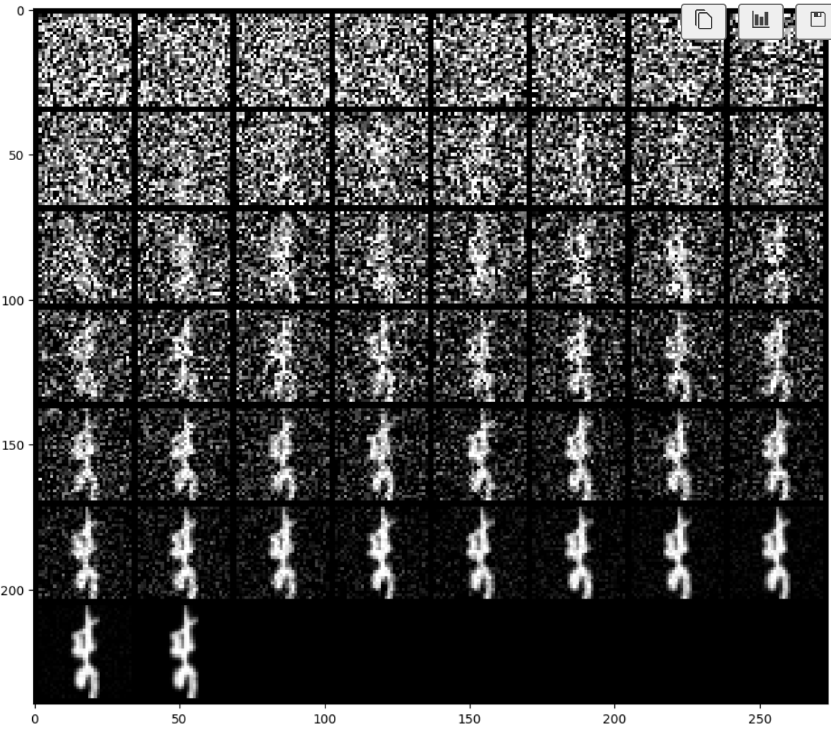
The Method - Example
To the right is an example of the degradation process; from bottom to top, the image is interpolated with static until it becomes unrecognizable.
Each of these steps is taken as an image with an interpolation value for the program to reference when building its idea of what a given step would look like for an image.

Slide 5
The Results
The resulting output should be a set of symbols mirroring the originals – to a degree.
Due to time constraints, I was limited on time to train the model. It’s taken a day so far to get this running through all of the epochs.
That being said, due to the lowered batch size and epoch count I had to give my program due to that time constraint, I estimate that the symbols may not resemble their original counterparts as well as I’d hope.
Currently, the program is running smoothly, and I await the results of its generation to report them later.

